Slide 1



Retail Inventory Management
Made by: Amin Mubarak
Supervisor:
Eng. Abdelrhman Elmashtoly
Track: Microsoft Data Engineer

Slide 2

Outlines
01
02
03
Project
Introduction
ERD
Dataset: Retail Inventory
BETA
04
05
Presented by: Team 5
Presented to: Eng. Abdelrhman Elmashtoly
Data Warehousing
ETL Process

Slide 3








Introduction
In today's dynamic retail environment, efficient inventory management is crucial for maintaining operational efficiency and meeting customer demands. The Retail Inventory Management and Forecasting project aims to develop a robust data warehouse using the AdventureWorks dataset to streamline inventory processes and enhance forecasting accuracy. By leveraging Azure Data Factory for data integration and transformation, this project will focus on four key tables: Products, Suppliers, Sales, and Inventory Levels.
The project will implement a structured approach to data handling, allowing for insightful analysis and predictive modeling. Through this initiative, we aim to provide retail businesses with actionable insights that optimize inventory levels, improve supplier relationships, and drive strategic decision-making.

Slide 4
Introduction
Manage retail inventory effectively.
Forecast demand using data from the Retail Inventory dataset.

Slide 5

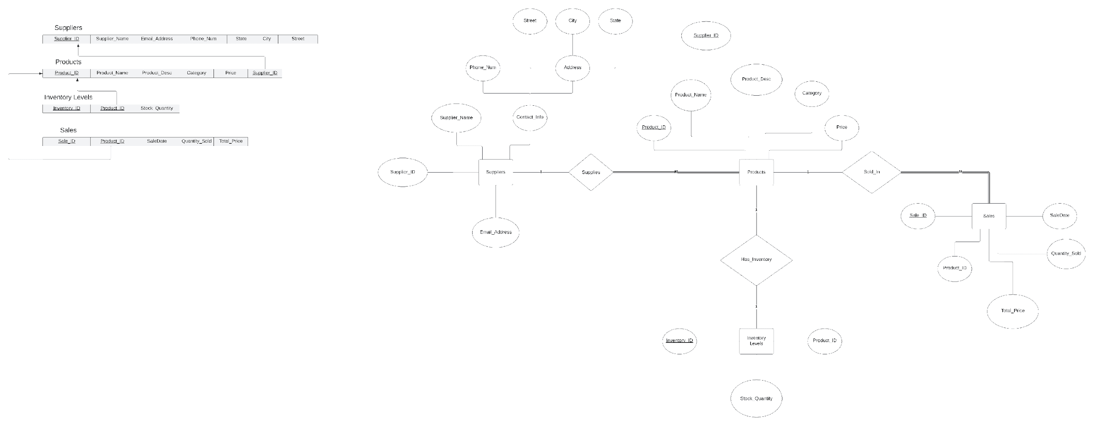
ERD
Diagram in a brief
Entities and Attributes
Relationships

Slide 6
ERD
Diagram in a brief
Entities and Attributes
Relationships

Slide 7
ERD
Retail Inventory Dataset Overview
Products
Suppliers
Sales
Inventory Levels

Slide 8
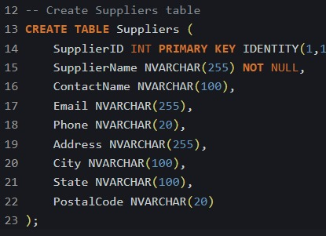
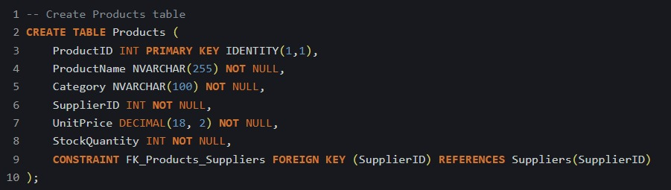
ERD
SQL

Slide 9
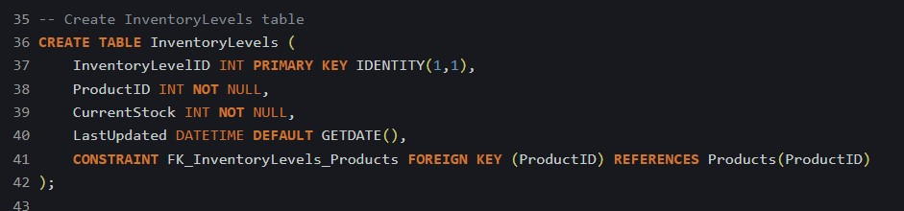
ERD
SQL

Slide 10
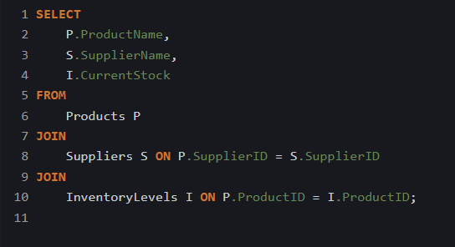
ERD
Query 1
Explanation: This query retrieves the names of products along with their corresponding suppliers and current inventory levels. It uses multiple JOIN statements to connect the Products, Suppliers, and InventoryLevels tables, providing a comprehensive view of each product's supplier and stock status.

Slide 11
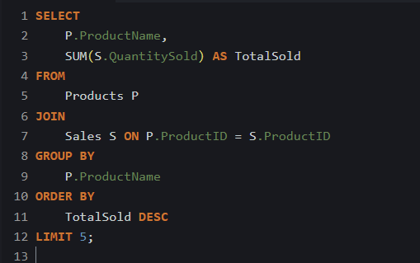
ERD
Query 2
Explanation: This query identifies the top five best-selling products by summing the QuantitySold from the Sales table. The results are grouped by product name and ordered in descending order based on the total sold, ensuring that only the top five products are displayed.

Slide 12
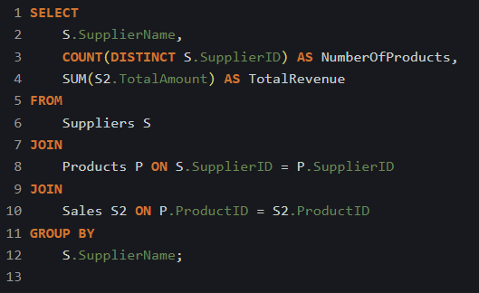
ERD
Query 3
Explanation: This query provides an overview of sales per supplier, showing the number of products supplied and total revenue generated from those products. It uses JOIN to link the Suppliers, Products, and Sales tables, grouping by supplier name to summarize their contributions to sales.

Slide 13
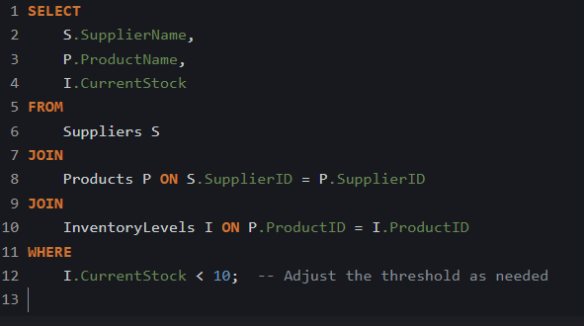
ERD
Query 4
Explanation: This query identifies suppliers and their products that have stock levels below a specified threshold (in this case, less than 10). It joins the Suppliers, Products, and InventoryLevels tables to provide a clear view of which suppliers are associated with low-stock products.

Slide 14
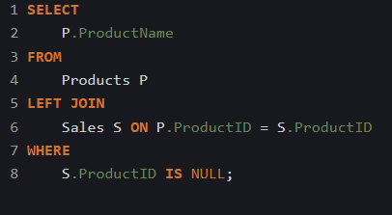
ERD
Query 5
Explanation: This query identifies products that have never been sold by performing a LEFT JOIN between the Products and Sales tables. It selects product names where the ProductID in the Sales table is NULL, indicating that there are no sales records for those products.

Slide 15
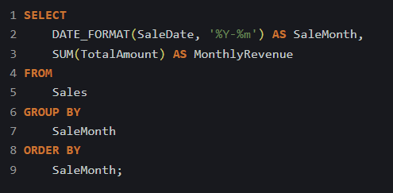
ERD
Query 6
Explanation: This query calculates the total revenue generated each month from sales. It formats the sale date to extract the year and month, groups the results by month, and sums the TotalAmount for each month, providing a timeline of revenue performance.

Slide 16
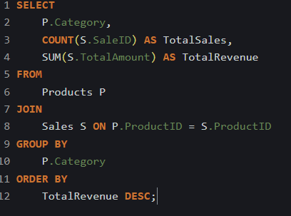
ERD
Query 7
Explanation: This query analyzes the sales performance by product category. It counts the total number of sales and calculates the total revenue for each category. The results are grouped by the Category from the Products table and ordered by total revenue in descending order, allowing you to identify which categories are performing best.

Slide 17
ERD
Data Warehouse Design
Tables Created:
FactSales
DimProducts
DimSuppliers
DimInventoryLevel

Slide 18
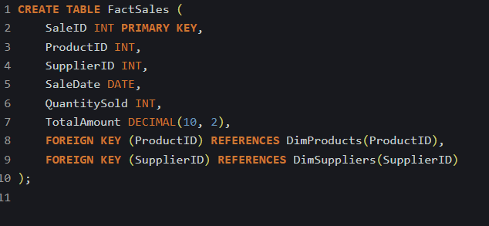
ERD
Data Warehouse Design

Slide 19
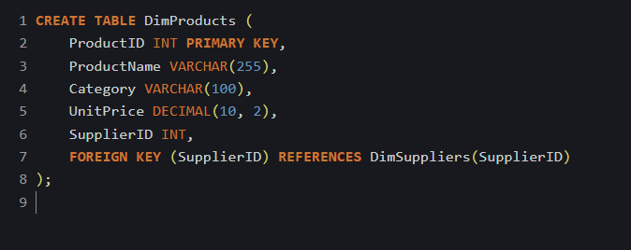
ERD
Data Warehouse Design

Slide 20
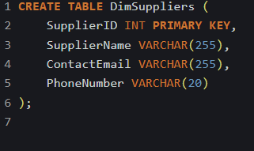
ERD
Data Warehouse Design

Slide 21
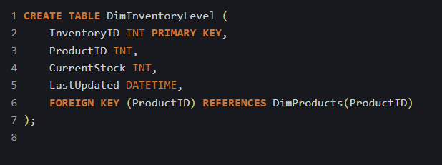
ERD
Data Warehouse Design

Slide 22



Thanks For Your Time

